Slide 1
CS6451: Advanced Software Design
Lect J: The Interceptor Part 2
J.J. Collins
Dept. of CSIS

Slide 2

Objectives Week 2
Work through the 7 steps to implement the Interceptor Architectural Pattern
Start on the Bridge Design Pattern
CS4227-CS5722 )
© www.infoq.com

Slide 3
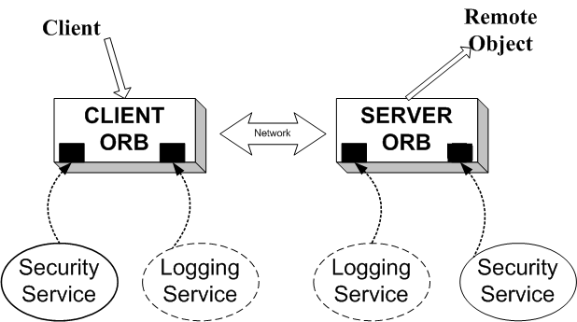
The Interceptor Architectural Pattern
A software house developing an Object Request Broker (ORB) middleware framework, based on broker architectural framework.
In addition to marshalling and unmarshalling service requests, middleware provides a basic set of services such as connection management and security.
Applications using the framework may require additional services such transaction support, load balancing, trader, logging, etc.

Slide 4
The Interceptor Architectural Pattern
Middleware Frameworks
Compiler generates stubs and skeletons
  As long as there is a language binding
Client makes a “local” call
Proxies, ORBs, and Broker do the heavy lifting
  Using an Interface Definition Language (IDL)
ORB is a kernel with core services
How can additional / out-of-band services be supported?
Client Code
(Remote) Method
Stub (Client Side Proxy)
Skeleton
(Server Side Proxy)
ORB on client machine
Broker
ORB on server machine

Slide 5
The Interceptor Architectural Pattern
Does not have to be a middleware framework
You release/sell an application
Client needs a bespoke logging service
Allow them to implement this out-of-band service by
  → building interceptor architectural pattern into application
For project:
  prove that your inceptor works by implementing logging as an out-of-band service
Logging Service
Application without logging service

Slide 6
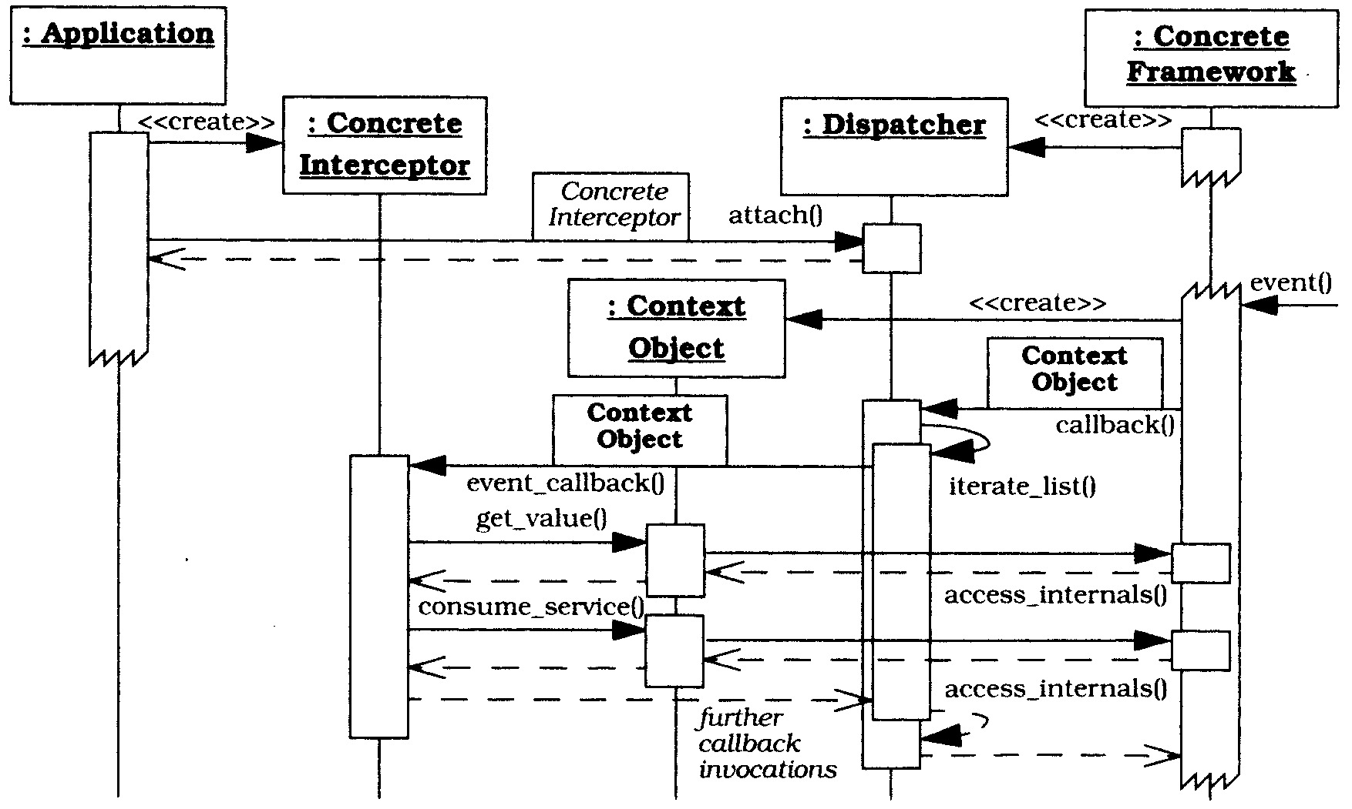
The Interceptor Architectural Pattern
Dynamics

Slide 7
The Interceptor Architectural Pattern
Framework (ORB) creates dispatcher(s)
  One or many?
Application creates concrete interceptors (out-of-band services) and registers them with dispatcher
  What is the interceptor interface?
  Who implements the interceptor?
In response to an event the framework
  Creates a Context Object – a handle that allows the out-of-band service to query and control the framework
    What is the API for the Context Object?
  The frameworks CALLS BACK to the dispatcher passing a reference to the context object
    How is the callback implemented?
  The dispatcher CALLS BACK to its registered concrete interceptors passing a reference to the Context Object
  The concrete interceptor can then query the framework and invoke framework services via the Context Object

Slide 8
The Interceptor: Consequences
Benefits:
Extensibility & flexibility
  Interceptors allow an application to evolve without breaking existing APIs & components
Separation of concerns
  Interceptors decouple the “functional” path from the “meta” path
Support for monitoring & control of frameworks
  e.g., generic logging mechanisms can be used to unobtrusively track application behaviour
Layer symmetry
  Interceptors can perform transformations on a client-side whose inverse are performed on the server-side
Reusability
  Interceptors can be reused for various general-purpose behaviours

Slide 9
The Interceptor: Consequences
Liabilities:
Complex design issues
  Determining interceptor APIs & semantics is non-trivial
Malicious or erroneous interceptors
Potential interception cascades
  Interceptors can result in infinite recursion

Slide 10
Known Uses
All middleware platforms
Glassfish
  https://glassfish.java.net/docs/v3/api/javax/interceptor/package-summary.html
Apache Tomcat
  http://tomcat.apache.org/tomcat-6.0-doc/config/cluster-interceptor.html
Document Interceptor for Sharepoint
  http://www.archibus.com/ai/abizfiles/v19.3_help/system-management-help/Content/web_services/webservices_example7.htm
Microsoft Internet Explorer to register plugins for specific media types.

Slide 11
The Interceptor Architectural Pattern
Seven steps to implement the Interceptor Architectural Pattern:
Model the Internal Behaviour of the Framework
Identify and Model Interception Points
Specify the Context Objects
Specify the Interceptors
Specify the Dispatchers
Implement the Callback Mechanisms in the Concrete Framework.
Implement the Concrete Interceptors

Slide 12
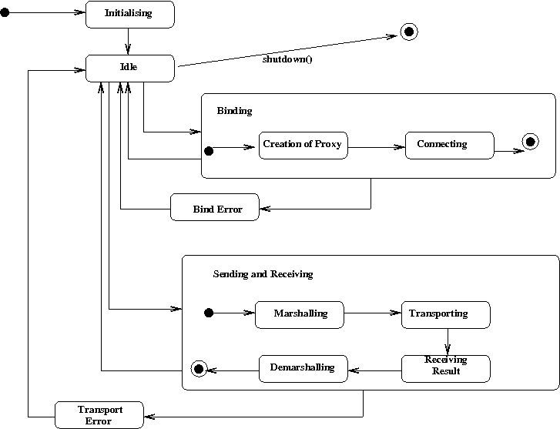
Step 1: Model the Internal Behaviour of the Framework
Create a composite state machine.
State machine for client side middleware platform – ORB in this example.
Capture the aspects
that are subject
to interception.

Slide 13
Step 2: Identify and Model Interception Points
(a) First, identify concrete framework state transitions that may not be visible to external applications, but are subject to interception.
Example:
  A client may wish to intercept an outgoing request so that it may add functionality such as logging, or modify the parameters dynamically such as Quality of Service arguments.
These state transitions constitute interception points.

Slide 14
Step 2: Identify and Model Interception Points
(b) Partition interception points into Reader and Writer sets.
Shown for client side only
Interception Point | Description | Reader / Writer
Binding | The client binds to a remote object. The framework creates a proxy and establishes communication. A monitoring service might intercept this event to visualise load. | Reader
PreMarshalOutRequest | Interceptors might change the target object to support load balancing, validate preconditions, or encrypt parameters. | Reader + Writer
PostMarshalOutRequest | A client might start a timer to measure latency | Reader
PreMarshalInReply | The reply has just arrived. A client may be interested in stopping a timer that measures latency | Reader
PostMarshalInReply | Evaluate post-conditions, decryption, validation of result, etc | Reader + Writer

Slide 15
Step 2: Identify and Model Interception Points
(c) Integrate interception points into the state machine model.
By introducing intermediary states
If a state transition is subject to interception, place a new transition between the source and sink states of the original transition.
(d) Partition into disjoint interception groups:
By analysing the state machine for interception points in the same area.

Slide 16
Step 2: Identify and Model Interception Points
Organise into Interception Groups
OutRequest
Interception Group
InRequest
Interception Group
Client Code
(Remote) Method
PreMarshalOutRequest
PostMarshalInRequest
Stub
Skeleton
(Server Side Stub)
PostMarshalOutRequest
PreMarshalInRequest
ORB
ORB

Slide 17
Step 2: Identify and Model Interception Points
Organise into Interception Groups
InReply
Interception Group
OutReply
Interception Group
Client Code
(Remote) Method
PostMarshalInReply
PreMarshalOutReply
Stub
Skeleton
(Server Side Stub)
PreMarshalInReply
PostMarshalOutReply
ORB
ORB

Slide 18
Step 2: Identify & Model Interception Points
The disjoint interception groups:
  OutRequest Interception Group
    PreMarshalOutRequest
    PostMarshalOutRequest
  InReply Interception Group
    PreMarshalInReply
    PostMarshalInReply
InRequest and OutReply on server side

Slide 19
Step 3: Specify the Context Objects
3.1 Determine the context object semantics
If an interception point belongs to a reader set, determine what information should be provided.
For writers, determine how to open the framework.
  For example, methods that can modify a parameter.
  Balance “open extensibility” versus “error prone interception code” that introduce vulnerabilities.
3.2 Determine the number of context objects
Multiple interfaces: different context objects for a diverse set of interception points, facilitates fine grained control, more work for client developers.
Single interface
  May result in a bloated context interface that is difficult to understand

Slide 20
Step 3: Specify the Context Objects
Example: intercepting outgoing events
  Reading and changing the target object to support load balancing
  Reading and modifying parameters to support encryption, validation, or change behaviour reflectively.
  Adding new data to the request such as security tokens or transaction contexts to add out of band information to the request.
  Integrating custom marshalling and unmarshalling components.

Slide 21
Step 3: Specify the Context Objects
Correspond to activities associated with
  PreMarshalOutRequest and
  PostMarshalOutRequest.
Introduce two context objects types
  UnmarshaledRequest
  MarshaledRequest

Slide 22
Step 3: Specify the Context Objects
public interface UnmarshaledRequest {
public String getHost();
public void setHost(String host);
public long getPort();
public long setPort(long newPort);
public String getObjName();
public void setObjName(String newName);
public String getMethod();
public void getMethod(String name);
public void addInfo(Object info);
// .............
}

Slide 23
Step 3: Specify the Context Objects
3.3 Determine how to pass context objects
  Per Registration: a context object is passed once and once only to a concrete interceptor upon registration
  Per-event
Determined usually by number of interfaces.
Per event has higher overheads due to repeated creation and deletion.

Slide 24
Step 4: Specify the Interceptors
An interceptor defines a generic interface that a concrete framework uses to invoke concrete interceptors via dispatchers when interception points are triggered.
An interceptor is defined for each interception group.
A designated callback hook method (signature) is specified for each interception point in a group.
The interceptor corresponds to the observer participant in the Observer Design Pattern.
Designated callback hook mechanism plays the role of “update()”
Interface for OutRequest Interception Group
public interface ClientRequestInterceptor {
public void onPreMarshalRequest (UnmarshaledRequest context);
public void onPostMarshaledRequest (MarshaledRequest context);
}

Slide 25
Step 5: Specify the Dispatchers
5.1 Specify the Interceptor registration interface.
To implement different callback policies, applications can pass a priority token when registering concrete interceptors with the dispatcher.
  Determines invocation order when multiple interceptors registered with same dispatcher
Helper class can automate registration process

Slide 26
Step 5: Specify the Dispatchers
1. public class ClientRequestDispatcher {
2.
3. Vector interceptors_;
4.
5. synchonized public void registerClientRequestInterceptor
6. (ClientRequestInterceptor i) {
7. interceptors_.addElement(i);
8. }
9.
10. synchonized public void removeClientRequestInterceptor
11. (ClientRequestInterceptor i) {
12. interceptors_.removeElement(i);
13. }
14. }

Slide 27
Step 5: Specify the Dispatchers
5.2 Specify the Dispatcher callback interface
When an interception event occurs, the framework callback to the dispatcher.
The dispatcher then invokes the designated callback hook method of its registered concrete interceptors.
A dispatcher often provides the same interface to the concrete framework that its associated interceptor offers to the dispatcher.
public class ClientRequestDispatcher implements ClientRequestInterceptor {
...............
}
Benefits
  Streamlines performance through delegation
  Localises the modifications required if dispatcher interface changes.
    Example: new interception point

Slide 28
Step 6: Implement the Callback Mechanisms in the Concrete Framework.
Use Observer Design Pattern
Dispatchers register with the concrete framework.
When an interception event occurs, the framework calls back to the designated method in the dispatcher.
Can pass the context as a parameter, or use a preallocated singleton.
Dispatcher can use strategy to allow applications to use different callback strategies – FIFO/LIFO, priority, Chain of Responsibility.

Slide 29
Step 6: Implement the Callback Mechanisms in the Concrete Framework.
1. public class ClientRequestDispatcher {
2. // ......
3. public void dispatchClientRequestInterceptorPreMarshal
4. ( UnMarshaledRequest context) {
5. Vector interceptors;
6. synchronized (this) {
7. interceptors = (Vector) interceptors.clone();
8. }
9. for(int i = 0; i < interceptors.size(); i++) {
10. ClientRequestInterceptor ic =
11. (ClientRequestInterceptor)interceptors.elementAt(i);
12. ic.onPreMarshalRequest(context);
13. }
14. }
15. // ..............
16. }

Slide 30
Step 7: Implement the Concrete Interceptors
1. public class Client {
2.
3. static final void main(Strings args[]) {
4.
5. ClientRequestInterceptor myInterceptor = new ClientRequestInterceptor () {
6. public void onPreMarshalRequest(UnMarshaledRequest context) {
7. System.out.println(context.getObj() + “called”);
8. // .............
9. }
10. public void onPostMarshalRequest(MarshaledRequest context) {
11. // ............
12. }
13. };
14.
15. ClientRequestDispatcher.theInstance().registerClientRequestInterceptor
16. (myInterceptor);
17. // Do Work
18. }
19. }

Slide 31
The Interceptor Architectural Pattern
Seven steps to implement the Interceptor Architectural Pattern:
Model the Internal Behaviour of the Framework
Identify and Model Interception Points
Specify the Context Objects
Specify the Interceptors
Specify the Dispatchers
Implement the Callback Mechanisms in the Concrete Framework.
Implement the Concrete Interceptors

Slide 32
The Interceptor Architectural Pattern
The dispatcher appears to play the role of a dynamic proxy
  Introduces another level of indirection that decouples callers from callees that are linked through callbacks.
This is found in the Abstract Client pattern that supports callbacks.
Patterns found in Gamma et al. including Bridge, Chain of Responsibility, Observer, and Strategy uses the Abstract Client.
The Reactor pattern [Schmidt], the Completion Callback pattern [Lea], the Conduits+ framework [Huni] also use the Abstract Client.
This pattern is central to OO programming, and is the easiest callback pattern to apply.
Java provides an interface facility for specifying Abstract Client interfaces.
In C, operational equivalence is facilitated by using pointers to functions.
For a layman’s overview, see Paul Jakubik (1997). Callback Implementations in C++.
Abstract client is further generalised by the adapter pattern.

Slide 33
The Interceptor Architectural Pattern
Interception is commonly used to handle security & transactions transparently.
It can also enable performance enhancement strategies
  e.g., just-in-time activation, object pooling, load balancing, & caching
Interceptor are a “meta-programming mechanism,” along with
  Smart proxies
  Pluggable protocols
  Gateways/bridges
  Interface repositories
Provide building-blocks to handle extensions, often unanticipated.
More on meta-programming:
  http://www.dre.vanderbilt.edu/~schmidt/PDF/IEEE.pdf

Slide 34
The Interceptor Architectural Pattern
Variants:
  Interceptor Proxy variant (also known as Delegator).
  Often used on the server side of a distributed system to intercept remote operations.
Interceptor facilitates service extensions to frameworks.
Used with Acceptor-Connector, Component Configurator, Active-Object, Monitor Object, Wrapper façade and other design patterns.
See Schmidt et al (2004). Pattern-Oriented Software Architecture – Volume 2:

Slide 35
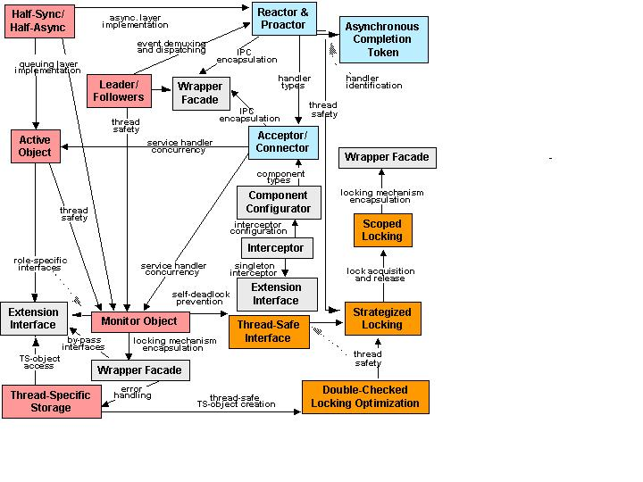
POSA 2 Catalogue

Slide 36
Architectural Patterns
Architectural patterns weaved together in a pattern language for middleware and applications
The Leader/Followers architectural pattern provides a concurrency model that allows multiple threads to share a set of event sources.
The Reactor architectural pattern structures event–driven applications, particularly servers that receive requests from multiple clients concurrently, but processes them sequentially.
The Proactor architectural pattern structures event-driven applications with long running asynchronous activities that receive service requests from concurrent clients

Slide 37
Homework
Lookup metaprogramming
http://www.dre.vanderbilt.edu/~schmidt/PDF/IEEE.pdf
Lookup callbacks
https://www.newty.de/jakubik/callback.pdf
Lookup interceptors versus filters in Spring Boot
CS4227-CS5722 )
© www.infoq.com

